Slide 1
Introduction to
Cascading Styles Sheets (CSS)
CSS Tutorial by Manu E S
Easy Learning with CSS “Enjoy The Course”

Slide 2
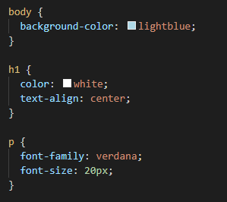
What is CSS ?
CSS is the language we use to style an HTML document.
CSS describes how HTML elements should be displayed.
This tutorial will teach you CSS from basic to advanced.

Slide 3
Why use CSS ?
CSS is used to define styles for your web pages, including the design,layout and variations in display for different
devices and screen sizes.
CSS Solved a Big Problem
HTML was NEVER intended to contain tags for formatting a web page!
HTML was created to describe the content of a web page, like:
<h1>This is a heading</h1>
<p>This is a paragraph.</p>
When tags like <font>, and color attributes were added to the HTML specification, it started a nightmare for web
developers. Development of large websites, where fonts and color information were added to every single page, became
a long and expensive process.
To solve this problem, the World Wide Web Consortium (W3C) created CSS.
CSS removed the style formatting from the HTML page!

Slide 4
Why use CSS ?
To solve this problem, the World Wide Web Consortium (W3C) created CSS.
CSS removed the style formatting from the HTML page!
CSS Saves a Lot of Work!
The style definitions are normally saved in external .css files.
With an external stylesheet file, you can change the look of an entire website by changing just one file!

Slide 5
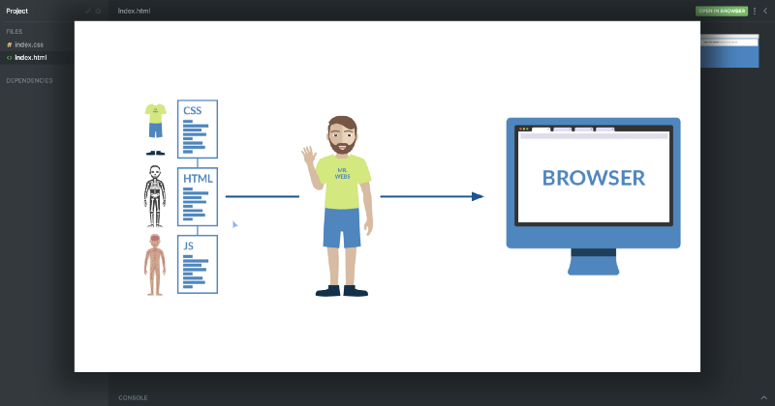
Why use CSS ?

Slide 6
Getting Started
Let’s start with learning how we can include CSS in our projects. There are typically three ways we do that.
Inline CSS
Internal CSS
External CSS

Slide 7
Inline CSS
First off, we can include CSS directly in our HTML elements. For this, we make use of the style attribute and then we
provide properties to it.
<h1 style="color: blue"> Hello world! </h1>
Here we’re giving it the property of color, and setting the value to blue, which results in the following:
We can also set multiple properties inside the style tag if we wanted. However, I don’t want to continue down this path,
as things start to get messy if our HTML is cluttered with lots of CSS inside it.
This is why the second method to include CSS was introduced.

Slide 8
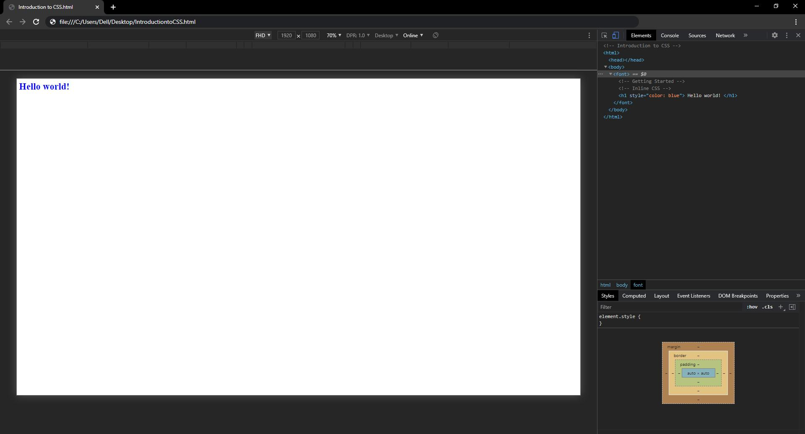
Inline CSS

Slide 9
Internal CSS
The other way to include CSS is using the style element in the head section of the HTML document. This is called
internal styling.
<head>
<style>
h1 {
color: blue;
}
</style>
</head>
In the style element, we can give the styling to our HTML elements by selecting the element(s) and provide styling
attributes. Just like we applied the color property to the h1 element above.

Slide 10
External CSS
The third and most recommended way to include CSS is using an external stylesheet. We create a stylesheet with a .css
extension and include its link in the HTML document, like this:
<head>
<link rel="stylesheet" href="style.css">
</head>
In the code above, we have included the link of style.css file using the link element. We then write all of our CSS in a
separate stylesheet called style.css so that it’s easily manageable.
h1 {
color: blue;
}
This stylesheet can also be imported into other HTML files, so this is great for reusability.

Slide 11
How to create your first css file ?
Step 1: Create a Folder Structure For Your Web Page
Let’s create a folder structure to support your web page. A well-designed folder structure will help you quickly
navigate to the HTML or CSS files that contain your code.
First, open Finder (in Mac) or Explorer (in Windows). Next, create a folder (also known as a directory) called
DevProject. This folder will contain all of the files for your HTML and CSS project.
Open the DevProject folder. Inside, create the following items:
A new file called index.html (use your preferred text editor)
A new folder called resources
The index.html file will contain the HTML code for your web page, while the resources folder will contain all of the
necessary resources needed by the HTML files (CSS files, images, etc.).

Slide 12
How to create your first css file ?
Next, open the newly created resources folder. Inside of this folder, create the following:
An additional folder named css
The css folder will contain the CSS files needed to style your web page.
Finally, open the css folder you just created. Inside of this folder, create the following:
A new file named index.css (use your preferred text editor)
The index.css file will contain all of the CSS styling rules that will be applied to your web page.
This overall folder structure will help support your workflow as you add files or resources. At a high-level, here’s
what it should look like:

Slide 13
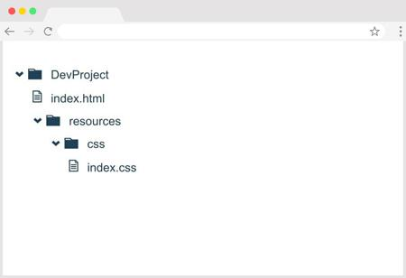
How to create your first css file ?
File manager Graphical Interface of the folder structure meant to be.

Slide 14
How to create your first css file ?
Step 2: Add Content To Your Web Page
Great! With your folder structure, HTML, and CSS files all in the right place, we can add content to the web page.
First, open the index.html file in your preferred text editor. Next, add the required boilerplate HTML code:
<!DOCTYPE html>
<html>
<head>
<title></title>
</head>
<body>
</body>
</html>

Slide 15
How to create your first css file ?
After you add the boilerplate HTML code, feel free to also add the following items:
Your own title between the <title> tags
Your own content within the
<body> tags. If you need some quick, pre-written content, feel free to use the following and modify as you wish:
<h1>FirstName LastName</h1>
<p>I'm learning to code on Codecademy! My goals include:</p>
<ul>
<li>Learn to code</li>
<li>Start a company</li>
<li>Help the world</li>
</ul>
<p>This is one of my favorite websites: <a href="https://www.google.com/" target="_blank">Google</a></p>

Slide 16
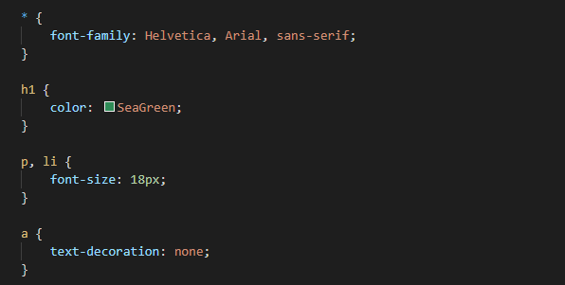
How to create your first css file ?
Finally, open the index.css file in your preferred text editor. Add the following pre-written CSS rules to the
file (feel free to modify as you wish):
Be sure to save your changes for both files!

Slide 17
How to create your first css file ?
Step 3: Link Your HTML File and CSS File
As it turns out, the HTML content you added will not be styled by the CSS rules unless index.html and index.css
are linked together. In the <head> section, link the stylesheet to the HTML file.
<link href="./resources/css/index.css" type="text/css" rel="stylesheet">
You might be wondering why the href attribute is set to ./resources/css/index.css. This is because you must
specify exactly where the index.css file lives within your folder(s) relative to where index.html lives
(otherwise, the two files won’t link).
If you have trouble linking your HTML and CSS, head to the Codecademy community forums for help.
Again, make sure to save your changes!

Slide 18
How to create your first css file ?
Step 4: View Your Project
Great work - let’s take a look at your web page in the browser.
Open your preferred web browser. In the menu bar, click on “File” and then click on “Open File…” (or
equivalent). Navigate to your index.html file and then click “Open” (or equivalent). The browser should load
your web page. What do you see?
At this point, feel free to make changes to your HTML or CSS code. Keep in mind that in order to view any
new changes you make, you’ll have to refresh your browser.

Slide 19
How to create your first css file ?
Review
Congrats! In this short time, you learned how to take what you’ve been learning and apply it using the
tools you have available on your own personal computer. You successfully learned how to:
Create a folder structure to support both your workflow and your web page
Add HTML content and CSS styling to respective files
Link the HTML and CSS files together
View your web page in a browser (and refresh the browser to view new changes)
In general, the four points above are a strong starting point for your own developer workflow. As you learn more, you
may modify the workflow to fit your specific needs. At this point, feel free to modify the content of the web page or
create an entirely new project. Happy coding!

Slide 20
CSS Selectors
CSS selectors are used to "find" (or select) the HTML elements you want to style.
We can divide CSS selectors into five categories:
Simple selectors (select elements based on name, id, class)
Combinator selectors (select elements based on a specific relationship between them)
Pseudo-class selectors (select elements based on a certain state)
Pseudo-elements selectors (select and style a part of an element)
Attribute selectors (select elements based on an attribute or attribute value)

Slide 21
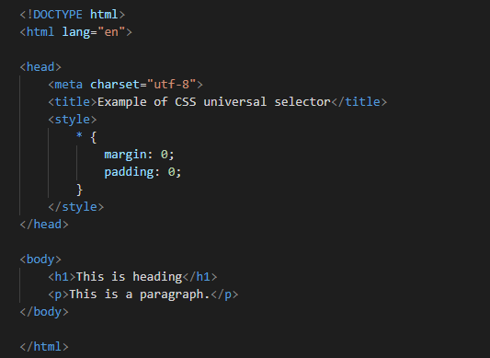
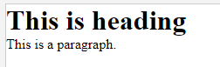
Universal Selector
The universal selector, denoted by an asterisk (*), matches every single element on the page.
The universal selector may be omitted if other conditions exist on the element. This selector is often used to remove
the default margins and paddings from the elements for quick testing purpose.
The style rules inside the * selector will be applied to every element in a document.

Slide 22
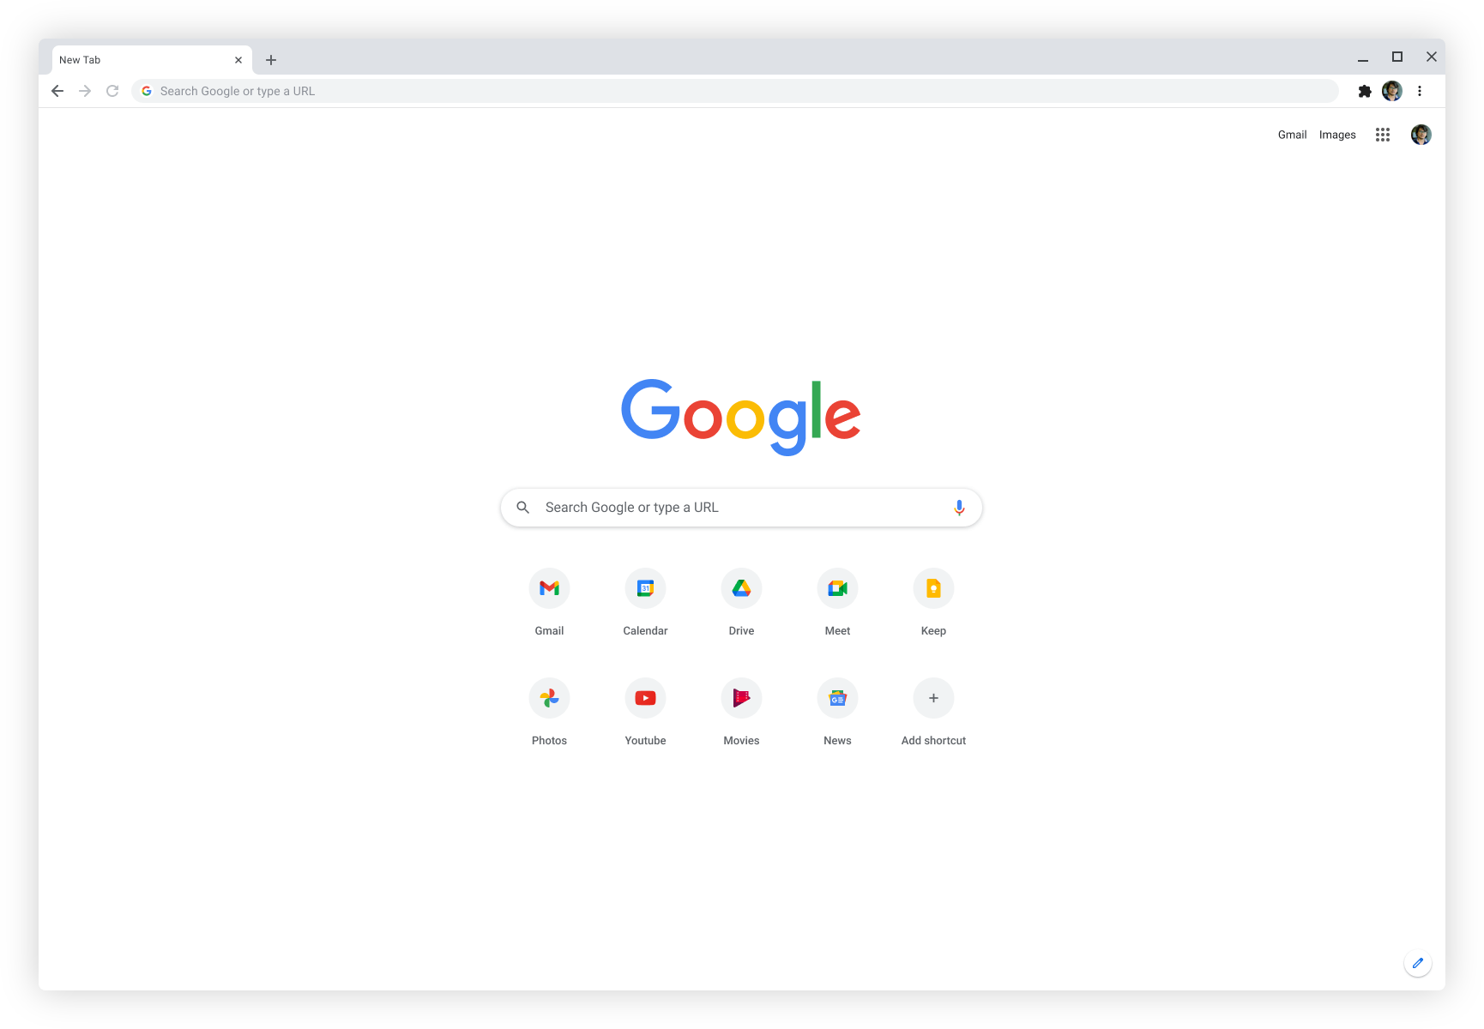
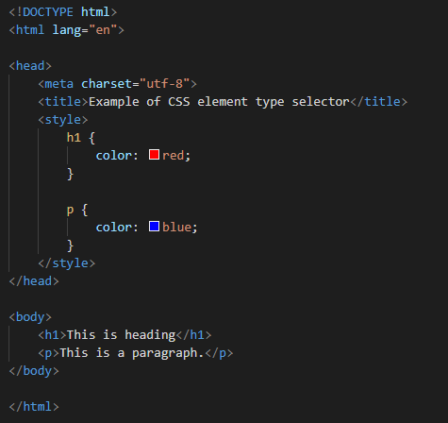
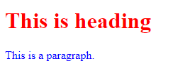
Element Type Selectors
An element type selector matches all instance of the element in the document with the corresponding element type name. Let's try out an example to see how it actually works:
The style rules inside the p selector will be applied on every <p> element (or paragraph) in the document and color it blue, regardless of their position in the document tree.

Slide 23
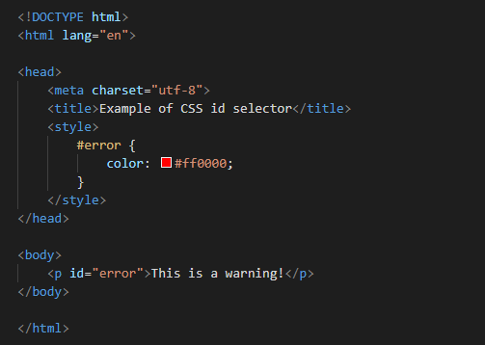
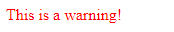
Id Selectors
The id selector is used to define style rules for a single or unique element.
The id selector is defined with a hash sign (#) immediately followed by the id value.
This style rule renders the text of an element in red, whose id attribute is set to error.
The value of an id attribute must be unique within a given document — meaning no two elements in your HTML document can share the same id value.

Slide 24
Id attribute
The id attribute specifies a unique id for an HTML element. The value of the id attribute must be unique within the HTML document. The id attribute is used to point to a specific style declaration in a style sheet. It is also used by JavaScript to access and manipulate the element with the specific id.
HTML Elements
An HTML element is defined by a start tag, some content, and an end tag.
The HTML element is everything from the start tag to the end tag:
<tagname>Content goes here...</tagname>
Examples of some HTML elements:
<h1>My First Heading</h1>
<p>My first paragraph.</p>

Slide 25
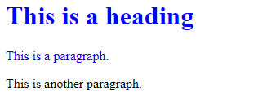
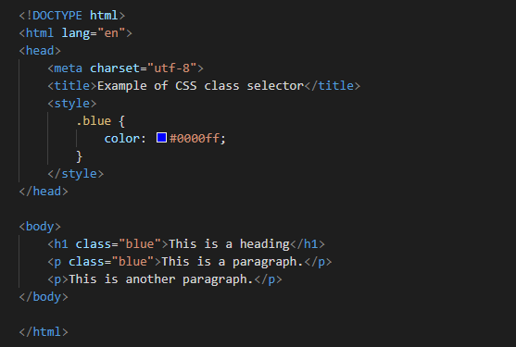
Class Selectors
The class selectors can be used to select any HTML element that has a class attribute. All the elements having that
class will be formatted according to the defined rule.
The class selector is defined with a period sign (.) immediately followed by the class value.
This style rule renders the text of an element in red, whose id attribute is set to error.
The value of an id attribute must be unique within a given document — meaning no two elements in your HTML document can share the same id value.

Slide 26
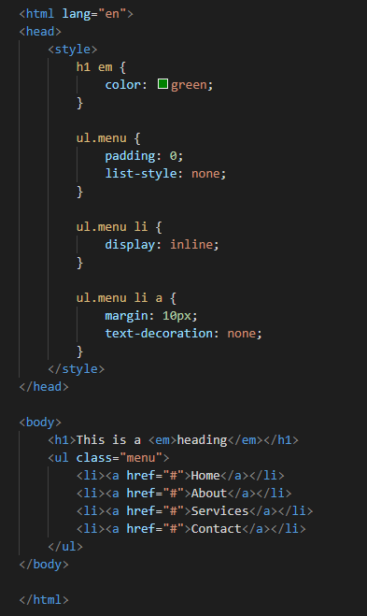
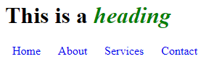
Descent Selectors
You can use these selectors when you need to select an element that is the descendant of another element, for example,
if you want to target only those anchors that are contained within an unordered list, rather than targeting all anchor
elements. Let's see how it works:
The style rules inside the selector ul.menu li a applied to only those <a> elements that contained inside an <ul>
element having the class .menu, and has no effect on other links inside the document.
Similarly, the style rules inside the h1 em selector will be applied to only those <em> elements that contained
inside the <h1> element and has not effect on other <em> elements.

Slide 27
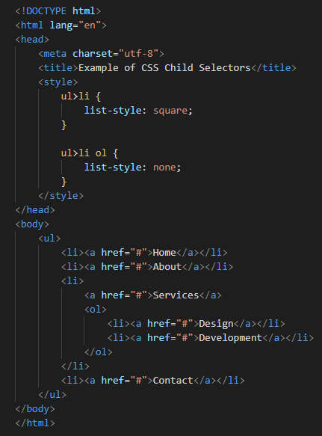
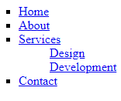
Child Selectors
A child selector is used to select only those elements that are the direct children of some element.
A child selector is made up of two or more selectors separated by a greater than symbol (>). You can use this selector,
for instance, to select the first level of list elements inside a nested list that has more than one level. Let's check
out an example to understand how it works:
The style rule inside the selector ul > li applied to only those <li> elements that are direct children of the <ul>
elements, and has no effect on other list elements.

Slide 28
Adjacent Sibling Selectors
The adjacent sibling selectors can be used to select sibling elements (i.e. elements at the same level). This selector
has the syntax like: E1 + E2, where E2 is the target of the selector.
The selector h1 + p in the following example will select the <p> elements only if both the
<h1> and <p> elements share the same parent in the document tree and
<h1> is immediately precedes the <p> element. That means only those paragraphs that come immediately after each
<h1> heading will have the associated style rules. Let's see how this selector actually works:

Slide 29
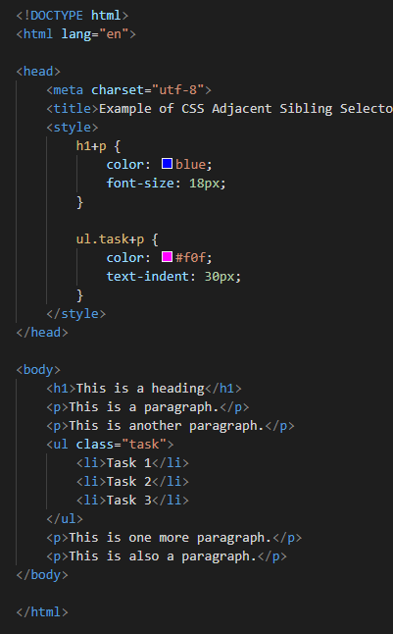
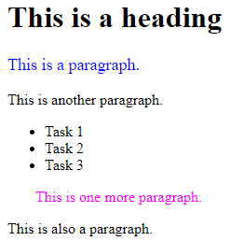
Adjacent Sibling Selectors

Slide 30
General Sibling Selectors
The general sibling selector is similar to the adjacent sibling selector (E1 + E2), but it is less strict. A general
sibling selector is made up of two simple selectors separated by the tilde (∼) character. It can be written like: E1 ∼
E2, where E2 is the target of the selector.
The selector h1 ∼ p in the example below will select all the <p> elements that preceded by the
<h1> element, where all the elements share the same parent in the document tree.

Slide 31
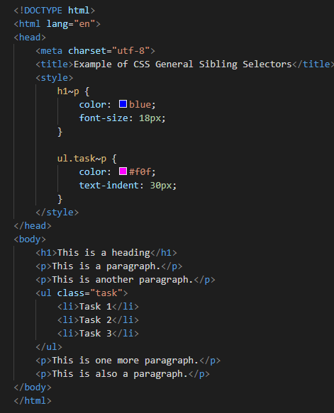
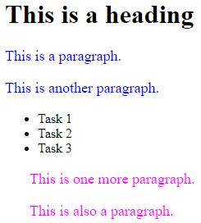
General Sibling Selectors
There are more sophisticated selectors like attribute selectors, pseudo-classes, pseudo-elements. We will discuss about
these selectors in detail in the upcoming chapters.

Slide 32
Grouping Selectors
Often several selectors in a style sheet share the same style rules declarations. You can group them into a
comma-separated list to minimize the code in your style sheet. It also prevents you from repeating the same style rules
over and over again. Let's take a look:

Slide 33
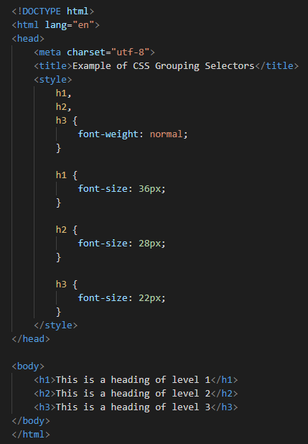
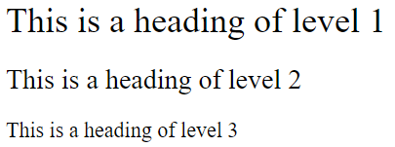
Grouping Selectors
As you can see in the above example, the same style rule font-weight: normal; is shared by the selectors h1, h2 and h3,
so it can be grouped in a comma-separated list.

Slide 34
Units
There are two types of units are used in CSS, Relative, and Absolute.
Relative units are relative to another length. If used, they can generate a flexible output across various media ( e.g
screen, print ). Absolute units are used to specify a fixed width irrespective of viewing area.Useful when the length of
the output medium is known.
Relative units used in CSS:
Unit Sign used Description
Pixel px Pixel of the viewing device.
em em The relevant font size.
ex ex The 'x-height' of the relevant font.

Slide 35
Units
Absolute units used in CSS
Unit Sign used Description
Inches in 1 inch is equal to 2.54 centimeters and approximately 96 pixels.
centimeters cm Known measurement unit.100cm = 1 meter.
Millimeters mm Known measurement unit.1000mm = 1 meter
Points pt 1 pt = 1/72 nd pf an inch.
Picas pc 1 pica = 12 points.

Slide 36
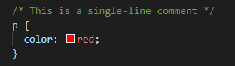
CSS Comments
Comments are used to explain the code, and may help when you edit the source code at a later date.
Comments are ignored by browsers.
A CSS comment is placed inside the <style>element, and starts with /* and ends with */:
You can add comments wherever you want in the code:

Slide 37
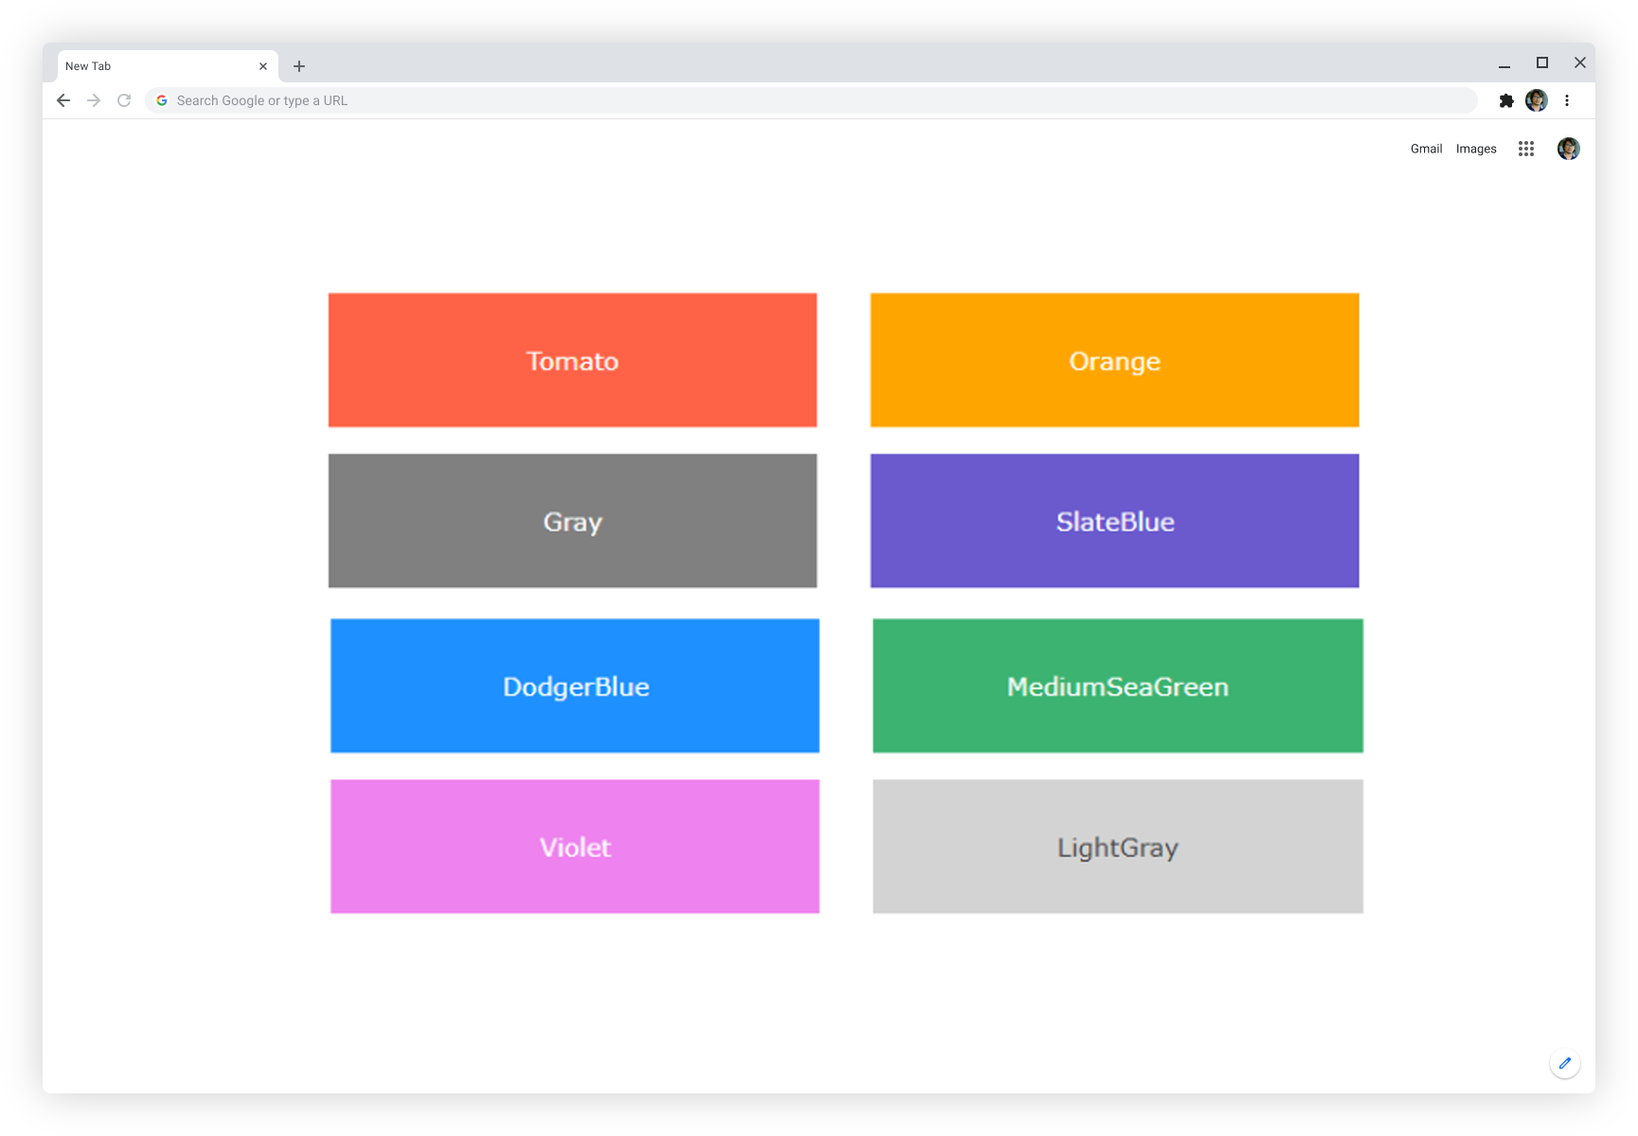
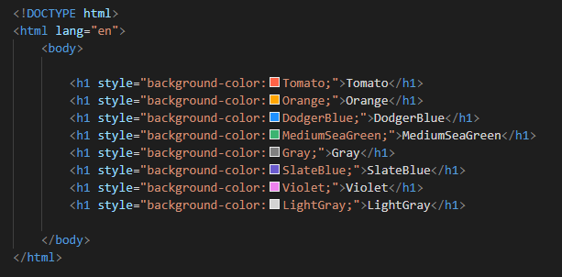
CSS Colors
Colors are specified using predefined color names, or RGB, HEX, HSL, RGBA, HSLA values.
In CSS, a color can be specified by using a predefined color name:

Slide 38
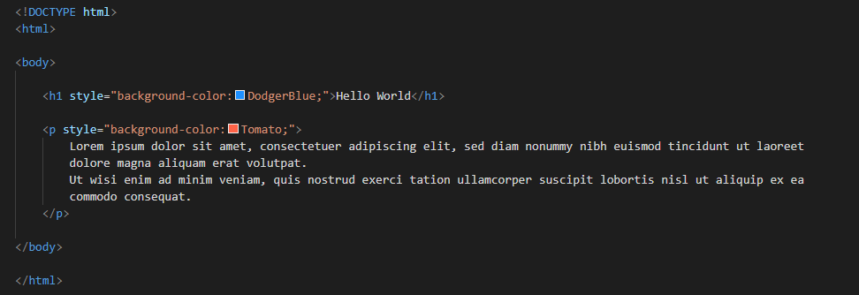
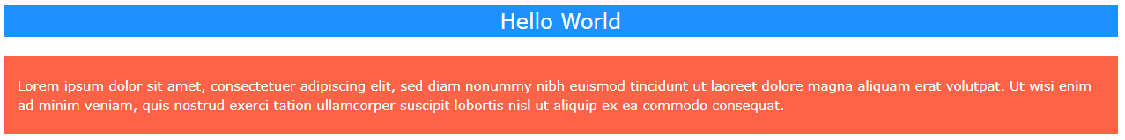
CSS Background Colors
You can set the background color for HTML elements:

Slide 39
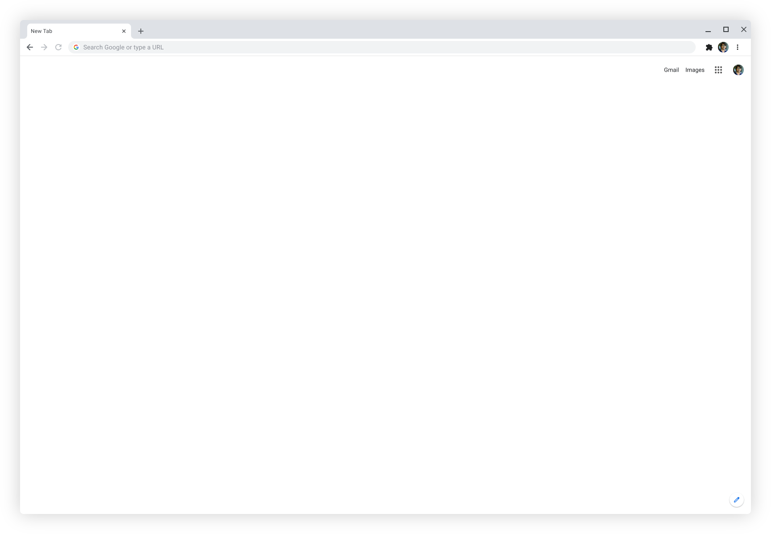
CSS Background Colors

Slide 40
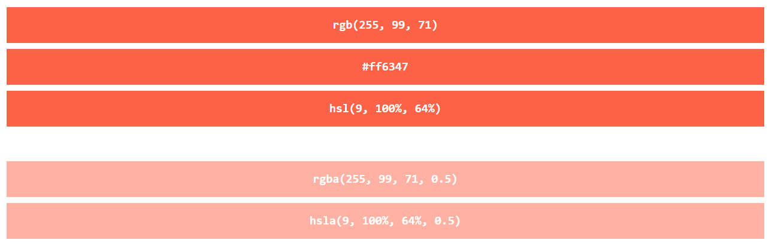
CSS Color Values
In CSS, colors can also be specified using RGB values, HEX values, HSL values, RGBA values, and HSLA values:
Same as color name "Tomato":
<h1 style="background-color:rgb(255, 99, 71);">...</h1>
<h1 style="background-color:#ff6347;">...</h1>
<h1 style="background-color:hsl(9, 100%, 64%);">...</h1>
<h1 style="background-color:rgba(255, 99, 71, 0.5);">...</h1>
<h1 style="background-color:hsla(9, 100%, 64%, 0.5);">...</h1>
50% Transparent

Slide 41
CSS Backgrounds
The CSS background properties are used to define the background effects for elements.
In this level, you will learn about the following CSS background properties:
background-color
background-image
background-repeat
Background-attachment
background-position

Slide 42
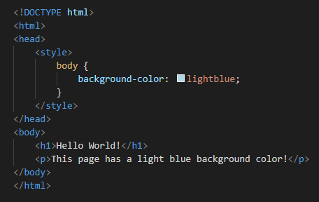
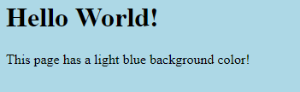
CSS background-color
The background-color property specifies the background color of an element.

Slide 43
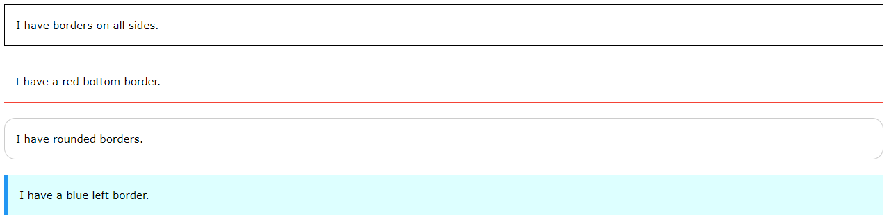
CSS Borders
CSS Border Properties
The CSS border properties allow you to specify the style, width, and color of an element's border.
CSS Border Style
The border-style property specifies what kind of border to display.

Slide 44
CSS Borders
The following values are allowed:
dotted - Defines a dotted border
dashed - Defines a dashed border
solid - Defines a solid border
double - Defines a double border
groove - Defines a 3D grooved border. The effect depends on the border-color value
ridge - Defines a 3D ridged border. The effect depends on the border-color value
inset - Defines a 3D inset border. The effect depends on the border-color value
outset - Defines a 3D outset border. The effect depends on the border-color value
none - Defines no border
hidden - Defines a hidden border
The border-style property can have from one to four values (for the top border, right border, bottom border, and the
left border).

Slide 45
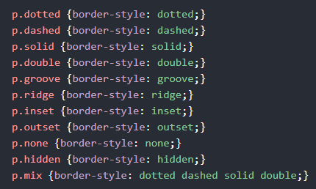
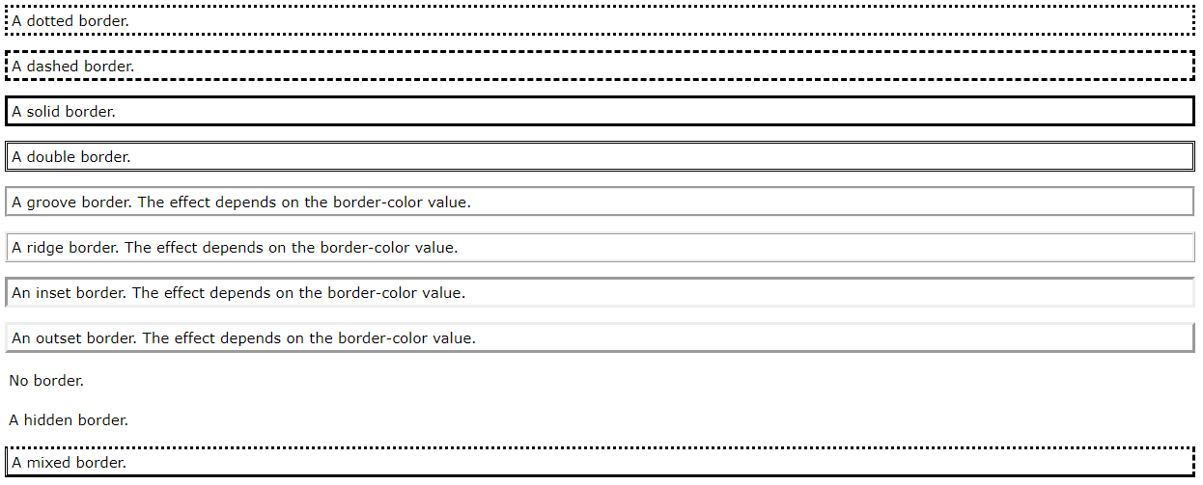
CSS Borders

Slide 46
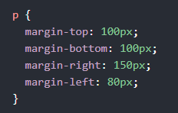
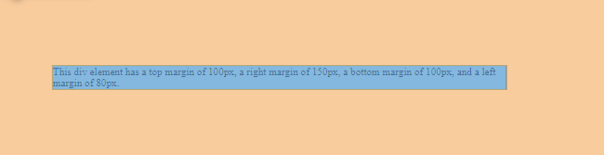
CSS Margin
The CSS margin properties are used to create space around elements, outside of any defined borders.
With CSS, you have full control over the margins. There are properties for setting the margin for each side of an
element (top, right, bottom, and left).
CSS has properties for specifying the margin for each side of an element:
margin-top
margin-right
margin-bottom
margin-left
All the margin properties can have the following values:
auto - the browser calculates the margin
length - specifies a margin in px, pt, cm, etc.
% - specifies a margin in % of the width of the containing element
inherit - specifies that the margin should be inherited from the parent element

Slide 47
CSS Padding
The CSS padding properties are used to generate space around an element's content, inside of any defined borders.
With CSS, you have full control over the padding. There are properties for setting the padding for each side of an
element (top, right, bottom, and left).
CSS has properties for specifying the padding for each side of an element:
padding-top
padding-right
padding-bottom
Padding-left
All the padding properties can have the following values:
length - specifies a padding in px, pt, cm, etc.
% - specifies a padding in % of the width of the containing element
inherit - specifies that the padding should be inherited from the parent element
Note: Negative values are not allowed.

Slide 48
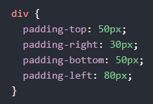
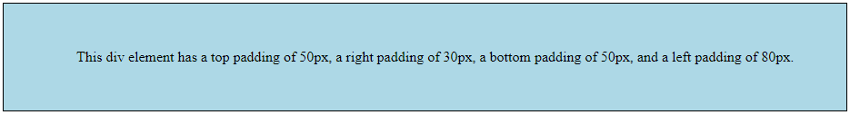
CSS Padding

Slide 49
CSS Height and Width
CSS Setting height and width
The height and width properties are used to set the height and width of an element.
The height and width properties do not include padding, borders, or margins. It sets the height/width of the area inside
the padding, border, and margin of the element.
CSS height and width Values
The height and width properties may have the following values:
auto - This is default. The browser calculates the height and width
length - Defines the height/width in px, cm etc.
% - Defines the height/width in percent of the containing block
initial - Sets the height/width to its default value
inherit - The height/width will be inherited from its parent value

Slide 50
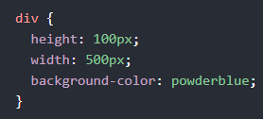
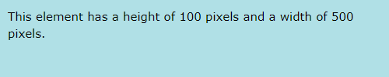
CSS Height and Width

Slide 51
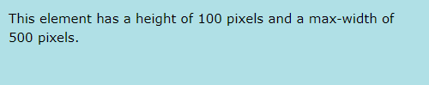
CSS Height and Width
Setting max-width
The max-width property is used to set the maximum width of an element.
The max-width can be specified in length values, like px, cm, etc., or in percent (%) of the containing block, or set to
none (this is default. Means that there is no maximum width).
The problem with the <div> above occurs when the browser window is smaller than the width of the element (500px). The
browser then adds a horizontal scrollbar to the page.
Using max-width instead, in this situation, will improve the browser's handling of small windows.
Tip: Drag the browser window to smaller than 500px wide, to see the difference between the two divs!
This element has a height of 100 pixels and a max-width of 500 pixels.
Note: The value of the max-width property overrides width.

Slide 52
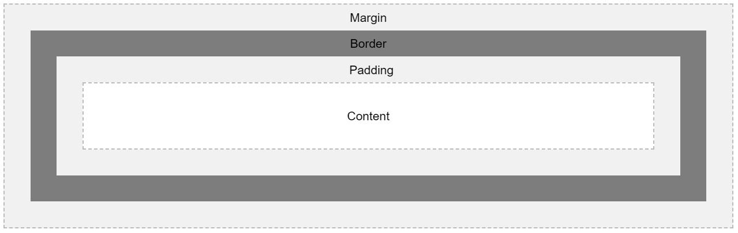
CSS Box Model
All HTML elements can be considered as boxes. In CSS, the term "box model" is used when talking about design and layout.
The CSS box model is essentially a box that wraps around every HTML element. It consists of: margins, borders, padding,
and the actual content. The image below illustrates the box model:

Slide 53
CSS Box Model
Explanation of the different parts:
Content - The content of the box, where text and images appear
Padding - Clears an area around the content. The padding is transparent
Border - A border that goes around the padding and content
Margin - Clears an area outside the border. The margin is transparent
The box model allows us to add a border around elements, and to define space between elements.

Slide 54
CSS align-content Property
The align-content property modifies the behavior of the flex-wrap property. It is similar to align-items, but instead of
aligning flex items, it aligns flex lines.
Note: There must be multiple lines of items for this property to have any effect!
Tip: Use the justify-content property to align the items on the main-axis (horizontally).
CSS Syntax:
align-content: stretch|center|flex-start|flex-end|space-between|space-around|initial|inherit;

Slide 55
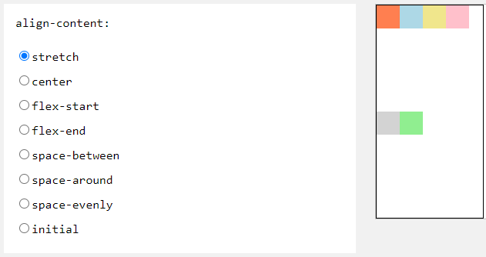
align-content:stretch;
display: flex;
flex-wrap: wrap;
align-content:stretch;

Slide 56
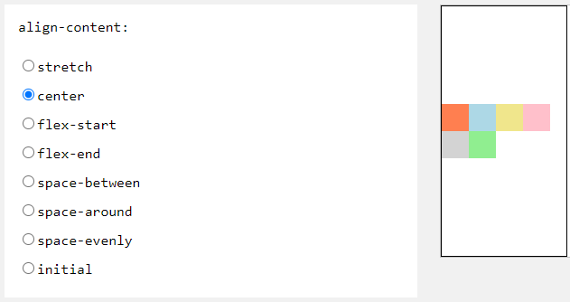
align-content:center;
display: flex;
flex-wrap: wrap;
align-content:center;

Slide 57
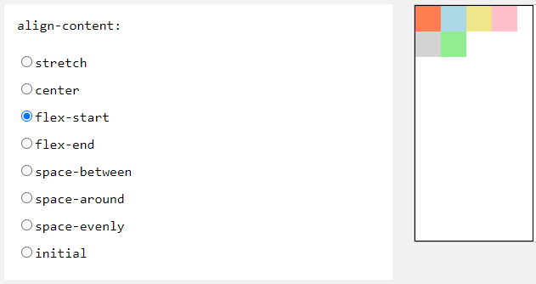
align-content:flex-start;
display: flex;
flex-wrap: wrap;
align-content:flex-start;

Slide 58
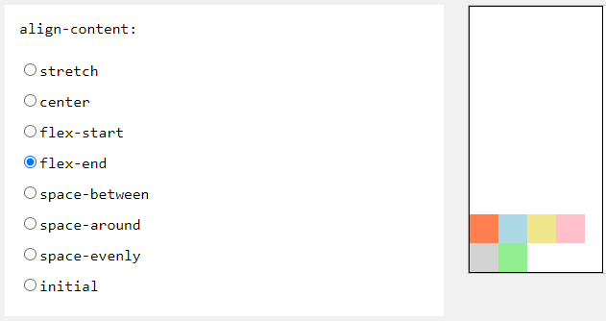
align-content:flex-end;
display: flex;
flex-wrap: wrap;
align-content:flex-end;

Slide 59
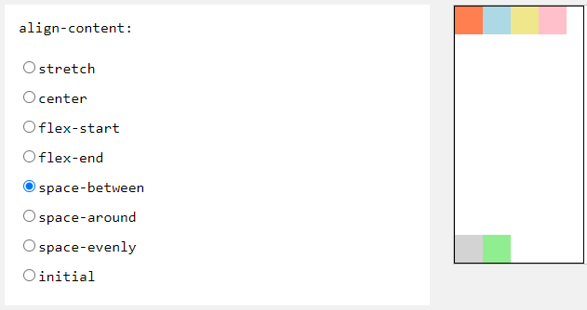
align-content:space-between;
display: flex;
flex-wrap: wrap;
align-content:space-between;

Slide 60
align-content:space-between;
display: flex;
flex-wrap: wrap;
align-content:space-between;

Slide 61
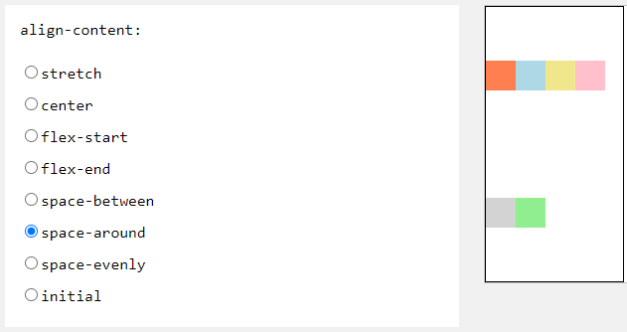
align-content:space-around;
display: flex;
flex-wrap: wrap;
align-content:space-around;

Slide 62

align-content:space-evenly;
display: flex;
flex-wrap: wrap;
align-content:space-evenly;

Slide 63

align-content:initial;
display: flex;
flex-wrap: wrap;
align-content:initial;

Slide 64
z-index property
The z-index property specifies the stack order of an element.
An element with greater stack order is always in front of an element with a lower stack order.
Note: z-index only works on positioned elements (position: absolute, position: relative, position: fixed, or position:
sticky).

Slide 65

z-index property
<div style="background-color:red;
width:300px;
height:100px;
z-index:2">
</div>
<div style="background-color:yellow;
width:300px;
height:100px;
z-index:1;">
</div>
<div style="background-color:green;
width:300px;
height:100px;
z-index:3;">
</div>

Slide 66
Default Browser Styles
html, body { display: block; }
address, blockquote, center, dialog, div, figure, figcaption, footer, form,
header, hr, legend, listing, main, p, plaintext, pre, xmp {
display: block;
}
blockquote, figure, listing, p, plaintext, pre, xmp {
margin-block-start: 1em; margin-block-end: 1em;
}
blockquote, figure { margin-inline-start: 40px; margin-inline-end: 40px; }
address { font-style: italic; }
listing, plaintext, pre, xmp {
font-family: monospace; white-space: pre;
}

Slide 67
Default Browser Styles
dialog:not([open]) { display: none; }
dialog {
position: absolute;
inset-inline-start: 0; inset-inline-end: 0;
width: fit-content;
height: fit-content;
margin: auto;
border: solid;
padding: 1em;
background: white;
color: black;
}
dialog::backdrop {
background: rgba(0,0,0,0.1);
}

Slide 68
Default Browser Styles
slot {
display: contents;
}
article, aside, h1, h2, h3, h4, h5, h6, hgroup, nav, section {
display: block;
}
dir, dd, dl, dt, menu, ol, ul { display: block; }
li { display: list-item; }
ol[type="1"], li[type="1"] { list-style-type: decimal; }
ol[type=a s], li[type=a s] { list-style-type: lower-alpha; }
ol[type=A s], li[type=A s] { list-style-type: upper-alpha; }
ol[type=i s], li[type=i s] { list-style-type: lower-roman; }
ol[type=I s], li[type=I s] { list-style-type: upper-roman; }
ul[type=none i], li[type=none i] { list-style-type: none; }

Slide 69
Default Browser Styles
ul[type=disc i], li[type=disc i] { list-style-type: disc; }
ul[type=circle i], li[type=circle i] { list-style-type: circle; }
ul[type=square i], li[type=square i] { list-style-type: square; }
table { display: table; }
caption { display: table-caption; }
colgroup, colgroup[hidden] { display: table-column-group; }
col, col[hidden] { display: table-column; }
thead, thead[hidden] { display: table-header-group; }
tbody, tbody[hidden] { display: table-row-group; }
tfoot, tfoot[hidden] { display: table-footer-group; }
tr, tr[hidden] { display: table-row; }
td, th { display: table-cell; }

Slide 70
Default Browser Styles
colgroup[hidden], col[hidden], thead[hidden], tbody[hidden],
tfoot[hidden], tr[hidden] {
visibility: collapse;
}
table {
box-sizing: border-box;
border-spacing: 2px;
border-collapse: separate;
text-indent: initial;
}
td, th { padding: 1px; }
th { font-weight: bold; }
caption { text-align: center; }
thead, tbody, tfoot, table > tr { vertical-align: middle; }
tr, td, th { vertical-align: inherit; }

Slide 71
Default Browser Styles
input, select, button, textarea {
letter-spacing: initial;
word-spacing: initial;
line-height: initial;
text-transform: initial;
text-indent: initial;
text-shadow: initial;
}
input, select, textarea {
text-align: initial;
}
input:is([type=reset i], [type=button i], [type=submit i]), button {
text-align: center;
}

Slide 72
Default Browser Styles
input:is([type=reset i], [type=button i], [type=submit i], [type=color i]), button {
display: inline-block;
}
input:is([type=radio i], [type=checkbox i], [type=reset i], [type=button i],
[type=submit i], [type=color i], [type=search i]), select, button {
box-sizing: border-box;
}
textarea { white-space: pre-wrap; }

Slide 73
Formatting Text in CSS
CSS allows us to format text to create visually appealing content. The following properties are used to style text using
CSS.
color
This property helps us change the text color.
letter-spacing
This property is used to set the spacing between characters.
line-height
The height of a line is specified using this property.

Slide 74
Formatting Text in CSS
text-align
The horizontal alignment of the text is controlled by text-align property.
text-decoration
To underline, strikethrough or overline and style it, text-decoration is used.
text-indent
The indentation of the first line of an element is set by the text-ident property.
text-shadow
To display a shadow around text, the text-shadow property is used.

Slide 75
Formatting Text in CSS
text-transform
The case of text can be set with the text-transform property.
word-spacing
The space between words can be set with this property.

Slide 76

Website Layout
Website Layout
A website is often divided into headers, menus, content and a footer:

Slide 77



Website Layout
The layout in this section, often depends on the target users. The most common layout is one (or combining them) of the
following:
1-column (often used for mobile browsers)
2-column (often used for tablets and laptops)
3-column layout (only used for desktops)

Slide 78
Who is a Web Developer
A web developer is a programmer who specializes in, or is specifically engaged in, the development of World Wide Web
applications using a client–server model .The applications typically use HTML, CSS and JavaScript in the client, PHP,
ASP.NET (C#), Python, Go or Java in the server, and http for communications between client and server. A web content
management system is often used to develop and maintain web applications.
What is development ?
Development is a process of writing and maintaining the source code, but in a broader sense, it includes all that is involved between the conception of the desired software through to the final manifestation of the software, sometimes in a planned and structured process.

Slide 79
CSS Fonts
Choosing the right font for your website is important!
Font Selection is Important
Choosing the right font has a huge impact on how the readers experience a website.
Using a font that is easy to read is important. The font adds value to your text. It is also important to choose the
correct color and text size for the font.
The CSS font-family Property
In CSS, we use the font-family property to specify the font of a text.
The font-family property should hold several font names as a "fallback" system, to ensure maximum compatibility between
browsers/operating systems. Start with the font you want, and end with a generic family (to let the browser pick a
similar font in the generic family, if no other fonts are available). The font names should be separated with comma.

Slide 80


CSS Fonts

Slide 81

CSS Fonts
Font Style
The font-style property is mostly used to specify italic text.
This property has three values:
normal - The text is shown normally
italic - The text is shown in italics
oblique - The text is "leaning" (oblique is very similar to italic, but less supported)
p.normal {
font-style: normal;
}
p.italic {
font-style: italic;
}
p.oblique {
font-style: oblique;
}

Slide 82

CSS Fonts
Font Weight
The font-weight property specifies the weight of a font.
Font Variant
The font-variant property specifies whether or not a text should be displayed in a small-caps font.
In a small-caps font, all lowercase letters are converted to uppercase letters. However, the converted uppercase letters
appears in a smaller font size than the original uppercase letters in the text.

Slide 83
CSS Links
Font Weight
The font-weight property specifies the weight of a font.
Font Variant
The font-variant property specifies whether or not a text should be displayed in a small-caps font.
In a small-caps font, all lowercase letters are converted to uppercase letters. However, the converted uppercase letters
appears in a smaller font size than the original uppercase letters in the text.
CSS Links
<a class="google_link" href="http://www.google.co.in">Visit Google</a>

Slide 84


CSS Links
In addition, links can be styled differently depending on what state they are in.
The four links states are:
a:link - a normal, unvisited link
a:visited - a link the user has visited
a:hover - a link when the user mouses over it
a:active - a link the moment it is clicked

Slide 85
CSS Links
HTML attributes provide additional information about HTML elements.
HTML Attributes
All HTML elements can have attributes
Attributes provide additional information about elements
Attributes are always specified in the start tag
Attributes usually come in name/value pairs like: name="value"
The href Attribute
The <a> tag defines a hyperlink. The href attribute specifies the URL of the page the link goes to:
<a href="https://loremipsum.com">Google Home Page</a>

Slide 86
CSS Display
CSS Layout - The display Property
The display property is the most important CSS property for controlling layout.
The display Property
The display property specifies if/how an element is displayed.
Every HTML element has a default display value depending on what type of element it is. The default display value for
most elements is block or inline.

Slide 87
CSS Display
Block-level Elements
A block-level element always starts on a new line and takes up the full width available (stretches out to the left and
right as far as it can).
The <div> element is a block-level element.
Examples of block-level elements:
<div>
<h1> - <h6>
<p>
<form>
<header>
<footer>
<section>

Slide 88
CSS Display
Inline Elements
An inline element does not start on a new line and only takes up as much width as necessary.
This is an inline <span> element inside a paragraph.
Examples of inline elements:
<span>
<a>
<img>
Display: none;
display: none; is commonly used with JavaScript to hide and show elements without deleting and recreating them. The <script> element uses display: none; as default.

Slide 89
CSS Display
CSS Layout - The position Property
The position property specifies the type of positioning method used for an element(static, relative, fixed, absolute or sticky).
The position property specifies the type of positioning method used for an element.
There are five different position values:
static
relative
fixed
absolute
sticky
Elements are then positioned using the top, bottom, left, and right properties.However, these properties will not work unless the position property is set first.They also work differently depending on the position value.

Slide 90
CSS Display
position: static;
HTML elements are positioned static by default.
Static positioned elements are not affected by the top, bottom, left, and right properties.
An element with position: static; is not positioned in any special way; it is always positioned according to the normal flow of the page:
div.static {
position: static;
}
position: relative;
An element with position: relative; is positioned relative to its normal position.
Setting the top, right, bottom, and left properties of a relatively - positioned element will cause it to be adjusted away from its normal position.Other content will not be adjusted to fit into any gap left by the element.
div.relative {
position: relative;
}

Slide 91
CSS Display
position: fixed;
An element with position: fixed; is positioned relative to the viewport, which means it always stays in the same place even if the page is scrolled.The top, right, bottom, and left properties are used to position the element.
A fixed element does not leave a gap in the page where it would normally have been located.
div.fixed {
position: fixed;
}

Slide 92

CSS Display
position: absolute;
An element with position: absolute; is positioned relative to the nearest positioned ancestor (instead of positioned relative to the viewport, like fixed).
However; if an absolute positioned element has no positioned ancestors, it uses the document body, and moves along with page scrolling.
Note: A "positioned" element is one whose position is anything except static.
Here is a simple example:

Slide 93
CSS Display
position: sticky;
An element with position: sticky; is positioned based on the user's scroll position.
A sticky element toggles between relative and fixed, depending on the scroll position. It is positioned relative until a given offset position is met in the viewport - then it "sticks" in place (like position:fixed).
div.sticky {
position: -webkit-sticky; /* Safari */
position: sticky;
}
Overlapping Elements
When elements are positioned, they can overlap other elements.
The z-index property specifies the stack order of an element (which element should be placed in front of, or behind, the others).
An element can have a positive or negative stack order:

Slide 94
CSS Overflow
The overflow property specifies whether to clip the content or to add scrollbars when the content of an element is too big to fit in the specified area.
The overflow property has the following values:
visible - Default. The overflow is not clipped. The content renders outside the element's box
hidden - The overflow is clipped, and the rest of the content will be invisible
scroll - The overflow is clipped, and a scrollbar is added to see the rest of the content
auto - Similar to scroll, but it adds scrollbars only when necessary

Slide 95
CSS Overflow
overflow: visible
By default, the overflow is visible, meaning that it is not clipped and it renders outside the element's box:
overflow: hidden
With the hidden value, the overflow is clipped, and the rest of the content is hidden:
overflow: scroll
Setting the value to scroll, the overflow is clipped and a scrollbar is added to scroll inside the box.Note that this will add a scrollbar both horizontally and vertically(even if you do not need it):
overflow: auto
The auto value is similar to scroll, but it adds scrollbars only when necessary:
overflow - x and overflow - y
The overflow - x and overflow - y properties specifies whether to change the overflow of content just horizontally or vertically(or both):
overflow - x specifies what to do with the left / right edges of the content.
overflow - y specifies what to do with the top / bottom edges of the content.

Slide 96

CSS Overflow
float: right;
The following example specifies that an image should float to the right in a text:
img {
float: right;
}

Slide 97

CSS Overflow
Example - float: left;
The following example specifies that an image should float to the left in a text:
img {
float: left;
}

Slide 98

What is Bootstrap ?
Bootstrap is the most popular CSS Framework for developing responsive and mobile-first websites.
Bootstrap 4 is the newest version of Bootstrap

Slide 99
What is Bootstrap ?
Browser Support:
Bootstrap 4 supports all major browsers except Internet Explorer 9.
If you require support for IE9 or IE8, you must use Bootstrap 3.
Bootstrap Containers:
The container class is one of the most important Bootstrap classes.
It provides margins, padding, alignments, and more, to HTML elements.
<!DOCTYPE html>
<html lang="en">
<head>
<title>Bootstrap Example</title>
<meta charset="utf-8">
<meta name="viewport" content="width=device-width, initial-scale=1">

Slide 100
What is Bootstrap ?
<link rel="stylesheet" href="https://maxcdn.bootstrapcdn.com/bootstrap/4.1.3/css/bootstrap.min.css">
<script src="https://ajax.googleapis.com/ajax/libs/jquery/3.3.1/jquery.min.js"></script>
<script src="https://cdnjs.cloudflare.com/ajax/libs/popper.js/1.14.3/umd/popper.min.js"></script>
<script src="https://maxcdn.bootstrapcdn.com/bootstrap/4.1.3/js/bootstrap.min.js"></script>
</head>
<body>
<div>
<h2>Without a Container</h2>
<p>The container class is one of the most important Bootstrap classes.</p>
<p>It provides margins, padding, alignments, and more, to HTML elements.</p>
</div>

Slide 101

What is Bootstrap ?
<div class="container-fluid">
<h2>With a Container</h2>
<p>The container class is one of the most important Bootstrap classes.</p>
<p>It provides margins, padding, alignments, and more, to HTML elements.</p>
</div>
</body>
</html>

Slide 102

Bootstrap Colors

Slide 103
Bootstrap Colors
<div class="container bg-primary text-white py-2">
<p>London is the most populous city in the United Kingdom, with a metropolitan area of over 9 million inhabitants.
</p>
</div>
<div class="container bg-success text-white py-2">
<p>London is the most populous city in the United Kingdom, with a metropolitan area of over 9 million inhabitants.
</p>
</div>
<div class="container bg-info text-white py-2">
<p>London is the most populous city in the United Kingdom, with a metropolitan area of over 9 million inhabitants.
</p>
</div>

Slide 104
Bootstrap Colors
<div class="container bg-warning xtext-white py-2">
<p>London is the most populous city in the United Kingdom, with a metropolitan area of over 9 million inhabitants.
</p>
</div>
<div class="container bg-danger text-white py-2">
<p>London is the most populous city in the United Kingdom, with a metropolitan area of over 9 million inhabitants.
</p>
</div>
<div class="container bg-secondary text-white py-2">
<p>London is the most populous city in the United Kingdom, with a metropolitan area of over 9 million inhabitants.
</p>
</div>

Slide 105
Bootstrap Colors
<div class="container bg-dark text-white py-2">
<p>London is the most populous city in the United Kingdom, with a metropolitan area of over 9 million inhabitants.
</p>
</div>

Slide 106

Bootstrap Text Colors
<div class="container">
<p class="text-muted">This text is muted.</p>
<p class="text-primary">This text is important.</p>
<p class="text-success">This text indicates success.</p>
<p class="text-info">This text represents some information.</p>
<p class="text-warning">This text represents a warning.</p>
<p class="text-danger">This text represents danger.</p>
</div>

Slide 107

Responsive Columns
<div class="container-fluid">
<h1>Hello World!</h1>
<p>Resize the browser window to see the effect.</p>
<p>The columns will automatically stack on top of each other when the screen is less than 576px wide.</p>

Slide 108
Responsive Columns
<div class="row">
<div class="col-sm-4" style="background-color:lavender;">.col-sm-3</div>
<div class="col-sm-4" style="background-color:lavenderblush;">.col-sm-3</div>
<div class="col-sm-4" style="background-color:lavender;">.col-sm-3</div>
</div>
</div>
For a full Bootstrap tutorial go to https://getbootstrap.com/.

Slide 109
CSS Theme
A theme is a structured template, written in a markup language called Cascading Style Sheets (CSS), that controls the
appearance and graphical layout of a page. The theme defines the font to be used, its size, the location of text,
colors, and background images.
A great use case for CSS variables is theming. Styling various aspects of our website in a different way, while still maintaining the overall look and feel. This often involves changing the colors, but sometimes includes fonts or icons.
What makes a CSS variable?
CSS variables differ from preprocessor variables in a number of ways. CSS variables are dynamic variables: Once set,
their value is not fixed. They can be updated with CSS or Javascript — so the same variable could have many different
values within different selectors in your stylesheet. Here we’re defining a variable we’ll call --primaryColor in three
different places. We’re setting the background-color property to the value of --primaryColor for the body and button
elements.

Slide 110

CSS Theme example
body {
--primaryColor: #d452f2;
background-color: var(--primaryColor);
}
button {
background-color: var(--primaryColor);
}
.my-element {
--primaryColor: #1a24a7; // the button inside `.my-element` will be blue
}
.my-element:nth-child(2n) {
--primaryColor: #4aa43e; // the button inside the second child will be green
}

Slide 111
SASS & LESS Preprocessor
Syntactically Awesome Stylesheets (Sass) and Leaner CSS (LESS) are both CSS preprocessors. They are special stylesheet
extensions that make designing easier and more efficient. Both Sass and LESS compile into CSS stylesheets so that
browsers can read them. This is a necessary step because modern browsers cannot read .sass or .less file types.
If you plan on being in the world of web development, it’s a good idea to be well-versed in one of the two
preprocessors—if not both of them. When it comes down to it, they have a lot of similarities. They make writing CSS
simpler, more object-oriented, and more enjoyable. Nevertheless, there are a few key differences.

Slide 112
Key differences (sass & less)
1. Sass Is in Ruby While LESS Is in Javascript Sass is based in Ruby and requires a Ruby install. This is no big deal if you have a Mac. However, it is a longer installation if you have a Windows machine.
LESS was constructed in Ruby, like Sass, but it has been ported to JavaScript. To use LESS, you must upload the applicable JavaScript files to your server or compile the CSS sheets through an offline compiler.
2. To Assign Variables, Sass Uses '$' While LESS Uses '@'
Both Sass and LESS use specialized characters to assign variables. This is part of the benefit of using these
preprocessors. You don’t have to keep entering specifications every time you want to assign variables. Instead, you can
just enter the character.
In Sass, it’s the dollar sign ($). In LESS, it’s the "at" symbol (@). The only downside for LESS is that there are a few
existing CSS selectors that already use @. That complication could stiffen the learning curve a bit.

Slide 113
Key differences (sass & less)
3. Sass Has Compass While LESS Has Preboot
Sass and LESS have extensions available to integrate mixins (the ability to store and share CSS declarations throughout a
site). Sass uses Compass for mixins, which includes every option available with updates for future support.
LESS has Preboot.less, LESS Mixins, LESS Elements, gs, and Frameless. LESS’s software support is more fragmented than
Sass, resulting in a lot of different options for extensions that may not all function the same way. For your project,
you may need to use multiple (or all) of the listed extensions to replicate the performance of Compass.
4. LESS Has Better Error Messages Than Sass
Both Sass and LESS have been tested for their ability to report errors in syntax. LESS has more accurate error messages
in the tests—it reported the correct location of the error. This can come in handy when a typo is derailing the code.
LESS error messages can help you quickly identify the problem.

Slide 114
Key differences (sass & less)
5. LESS Has More User-Friendly Documentation Than Sass
The LESS documentation is visually appealing and easier to follow for first-time users. The Sass documentation requires
either much more of base knowledge, or frequent cross-references with a wiki during setup.​​
This fact in and of itself could weigh heavily on the adoption rates of either Sass or LESS.

Slide 115

Responsive Web Design - Media Queries
What is a Media Query?
Media query is a CSS technique introduced in CSS3.
It uses the @media rule to include a block of CSS properties only if a certain condition is true.
Add a Breakpoint
Earlier in this tutorial we made a web page with rows and columns, and it was responsive, but it did not look good on a small screen.
Media queries can help with that. We can add a breakpoint where certain parts of the design will behave differently on each side of the breakpoint.

Slide 116


Responsive Web Design - Media Queries
Desktop
Mobile

Slide 117
Summary
This level has taught you how to create style sheets to control the style and layout of multiple web sites at once.
You have learned how to use CSS to add backgrounds, format text, add and format borders, and specify padding and margins of elements.
You have also learned how to position an element, control the visibility and size of an element, set the shape of an element, place an element behind another, and to add special effects to some selectors, like links.

Slide 118

Assignment 1
Try it using flex, float and grid

Slide 119

Assignment 2

Slide 120

Projects:
1. Simple responsive photo gallery template

Slide 121

Projects:
2. Responsive signup form

Slide 122

Projects:
3. HTML CSS Responsive Web design template

Slide 123
Thank You
See You in Level 3 ...!!!

